Slide 1
CSS342 Data Structures, Algorithms, and Discrete Mathematics (I)

Slide 2
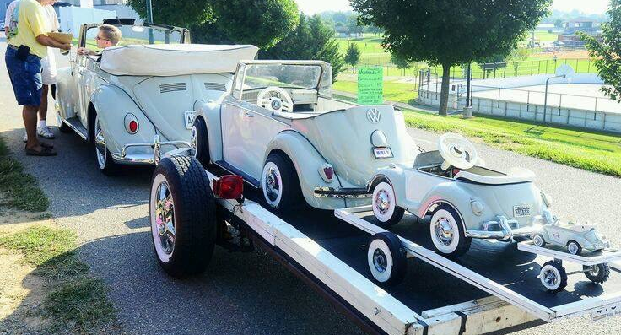
Recursion

Slide 3

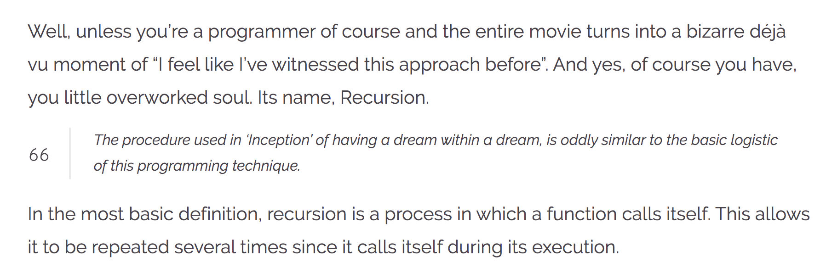
Recursion
https://wewrite.taleas.io/2018/11/14/why-inception-reminds-us-of-recursion/

Slide 4
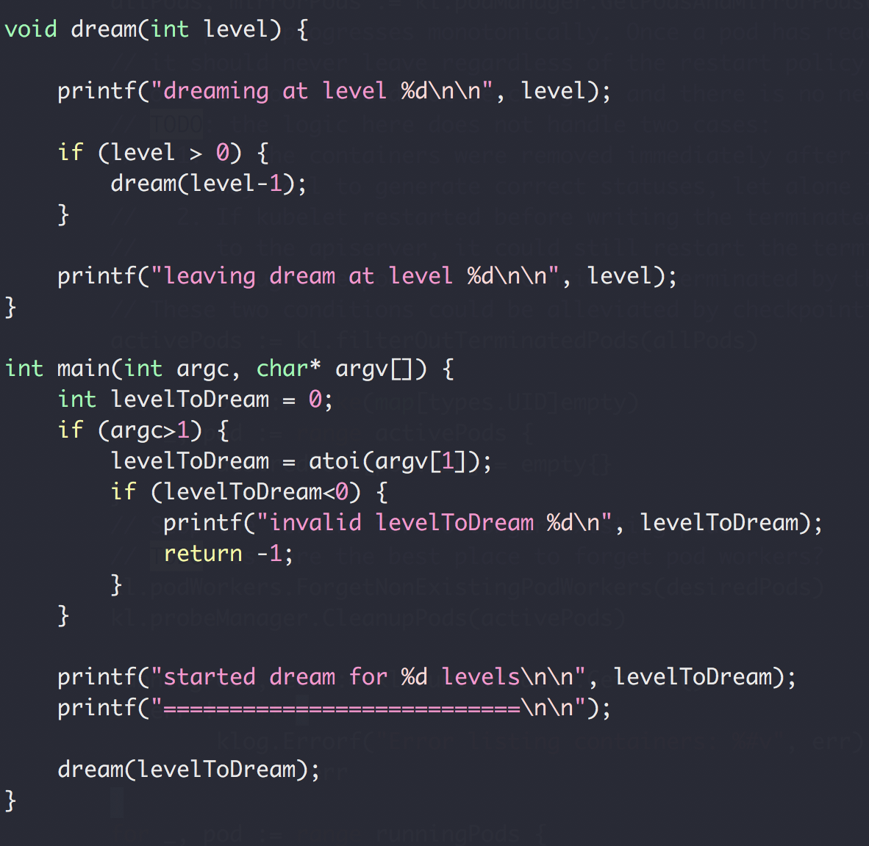
Dream in Recursion

Slide 5
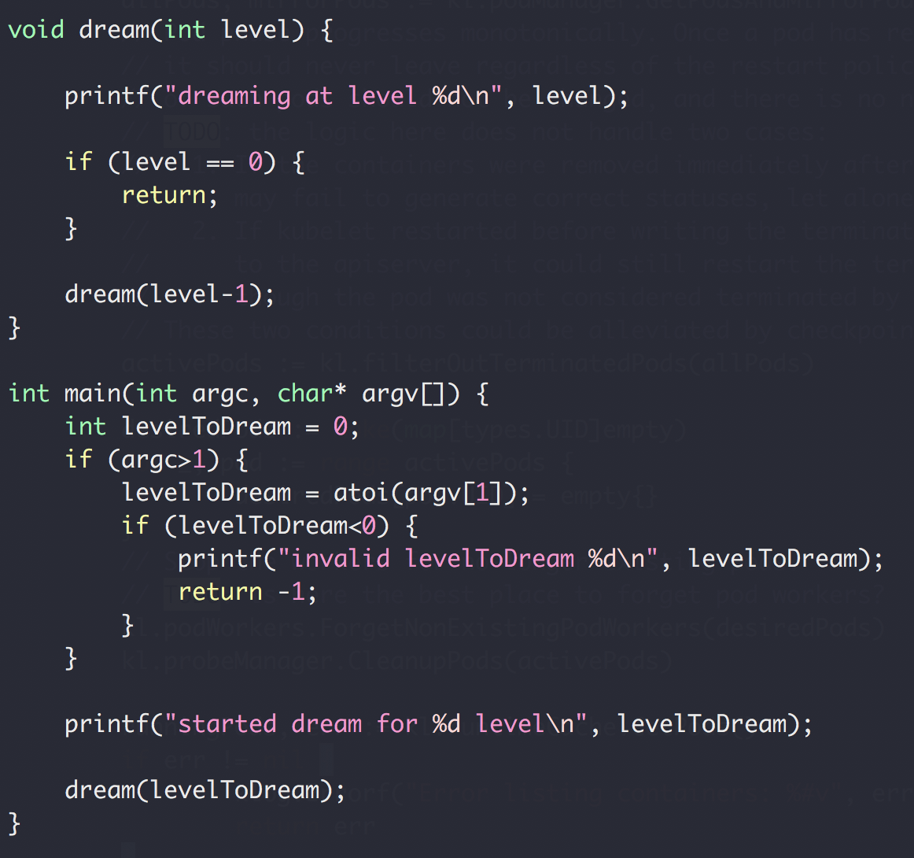
Recursion (and backtracking)
Recursion
Split a problem in a smaller subproblem of the same kind
Call self for each subproblem
Stop the recursion when the subproblem is ”small enough” and can be solved directly

Slide 6
Function Call Stack
Heap
Foo() {
// stack
int array1[10];
// heap
int * array2 = new int[20];
delete array2;
}
Foo() {
int array1[10];
int * array2 = new int[20];
delete array2;
}
Stack
Memory

Slide 7
Function Call Stack
Heap
Dream(1)
dream(0)
Dream(0)
Return address of dream(1)
Stack
dream(1)
Return address of main()
main()
Memory
Stack buffer overflow attack

Slide 8
Function Call Stack
Heap
dream(N-4)
Return address of dream(N-3)
dream(N-3)
Return address of dream(N-2)
dream(N-2)
Return address of dream(N-1)
Stack
dream(N-1)
Return address of main()
main()
Memory

Slide 9
Recursion (and backtracking)
Recursion
Split a problem in a smaller subproblem of the same kind
Call self for each subproblem
Stop the recursion when the subproblem is ”small enough” and can be solved directly

Slide 10
Recursion (and backtracking)
Recursion
Split a problem in a smaller subproblem of the same kind
Call self for each subproblem
Stop the recursion when the subproblem is ”small enough” and can be solved directly

Slide 11
Homework Issues
DO NOT SUBMIT .o and .x files
Problem 1, need to verify capacity
If else
2D matrix array memory leak
Do not remove existing code. Only add.
Class file name should match the class
Include cpp file (problem 2)
Matrix constructor no static initialization
Need to verify deep copy (cannot just loop and check value)

Slide 12
Recursion (and backtracking)
How to find the largest apple
In box 0 to 5
0
1
2
3
4
5
Largest apple:
1
1
0

Slide 13
Recursion (and backtracking)
How to find the largest apple
In box 0 to 5 (noted as [0,5])
Get the first apple from [0,5]
Find the largest apple from [1,5]
compare it with apple 0
0
1
2
3
4
5

Slide 14
Recursion (and backtracking)
How to find the largest apple
In box 1 to 5
Get the first apple from [1,5]
Find the largest apple from 2-5
compare it with apple 1
0
1
2
3
4
5

Slide 15
Recursion (and backtracking)
How to find the largest apple
In box 2 to 5
Get the first apple from [2,5]
Find the largest apple from 3-5
compare it with apple 2
0
1
2
3
4
5

Slide 16
Recursion (and backtracking)
How to find the largest apple
In box 1 to 5
Get the first apple from [3,5]
Find the largest apple from 3-5
compare it with apple 3
0
1
2
3
4
5

Slide 17
Recursion (and backtracking)
How to find the largest apple
In box 1 to 5
Get the first apple from [4,5]
Find the largest apple from 4-5
compare it with apple 4
0
1
2
3
4
5

Slide 18
Recursion (and backtracking)
How to find the largest apple
In box 1 to 5
Only 1 apple is left, it’s the largest comparing to itself
0
1
2
3
4
5

Slide 19
Recursion (and backtracking)
How to find the largest apple
In box 1 to 5
Get the first apple from [4,5]
Find the largest apple from 4-5
compare it with apple 4
0
1
2
3
4
5

Slide 20
Recursion (and backtracking)
How to find the largest apple
In box 1 to 5
Get the first apple from [4,5]
Find the largest apple from 4-5
compare it with apple 4
0
1
2
3
4
5

Slide 21
Recursion (and backtracking)
How to find the largest apple
In box 1 to 5
Get the first apple from [3,5]
Find the largest apple from 3-5
compare it with apple 3
0
1
2
3
4
5

Slide 22
Recursion (and backtracking)
How to find the largest apple
In box 1 to 5
Get the first apple from [3,5]
Find the largest apple from 3-5
compare it with apple 3
0
1
2
3
4
5

Slide 23
Recursion (and backtracking)
How to find the largest apple
In box 2 to 5
Get the first apple from [2,5]
Find the largest apple from 3-5
compare it with apple 2
0
1
2
3
4
5

Slide 24
Recursion (and backtracking)
How to find the largest apple
In box 1 to 5
Get the first apple from [1,5]
Find the largest apple from 2-5
compare it with apple 1
0
1
2
3
4
5

Slide 25
Recursion (and backtracking)
How to find the largest apple
In box 1 to 5
Get the first apple from [1,5]
Find the largest apple from 2-5
compare it with apple 1
0
1
2
3
4
5

Slide 26
Recursion (and backtracking)
How to find the largest apple
In box 1 to 5
Get the first apple from [1,5]
Find the largest apple from 2-5
compare it with apple 1
0
1
2
3
4
5

Slide 27
Recursion (and backtracking)
How to find the largest apple
In box 0 to 5 (noted as [0,5])
Get the first apple from [0,5]
Find the largest apple from [1,5]
compare it with apple 0
0
1
2
3
4
5

Slide 28
Recursion (and backtracking)
How to find the largest apple
In box 0 to 5 (noted as [0,5])
Get the first apple from [0,5]
Find the largest apple from [1,5]
compare it with apple 0
0
1
2
3
4
5

Slide 29
A similar question
Find the largest number in an array
Array not sorted
interger
0
1
2
3
4
5

Slide 30
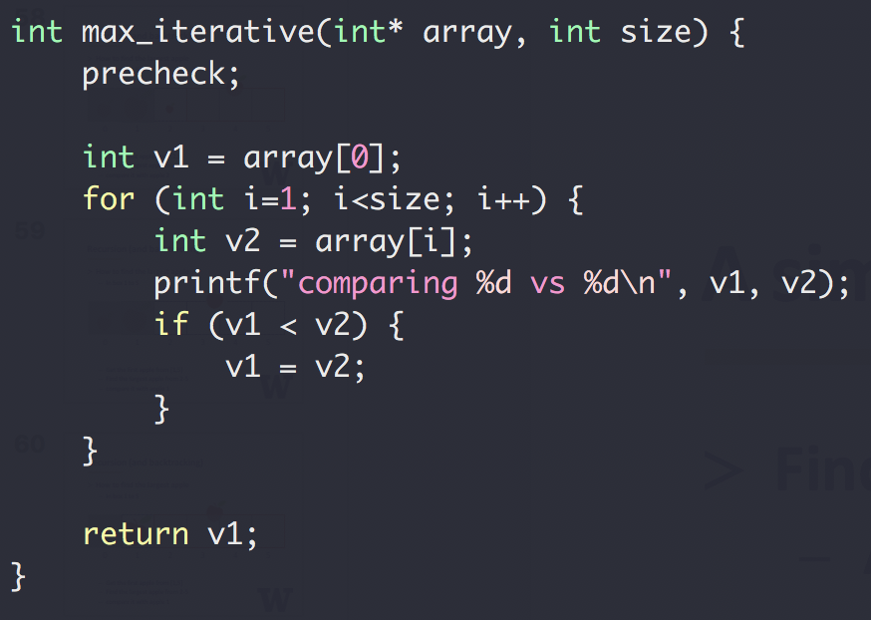
A similar question
Find the largest number in an array
Array not sorted
Integer
Method 1
Iterative

Slide 31
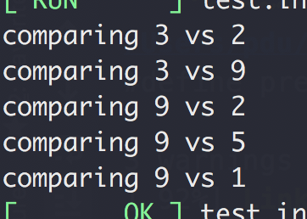
A similar question
Find the largest number in an array
Array not sorted
Integer
Method 1
Iterative
Input: [3,2,9,2,5,1]

Slide 32
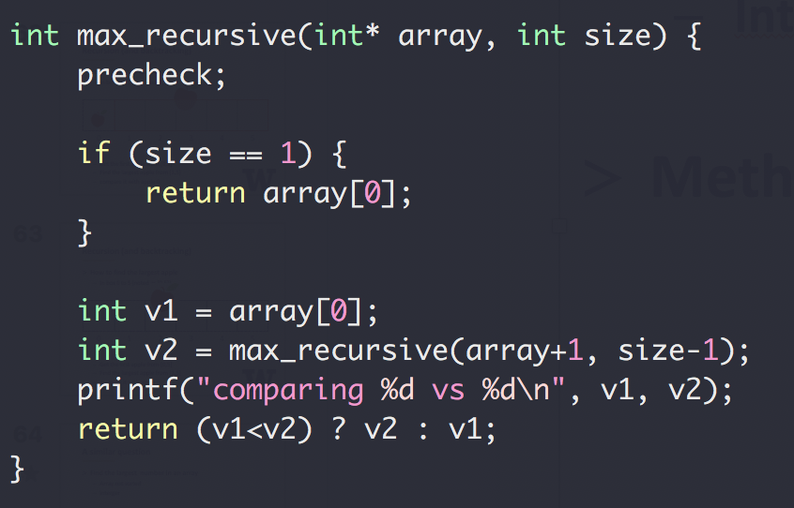
A similar question
Find the largest number in an array
Array not sorted
Integer
Method 2
Recursive

Slide 33
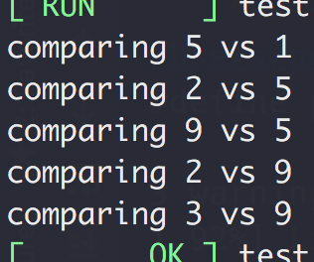
A similar question
Find the largest number in an array
Array not sorted
Integer
Method 1
Recursive
Input: [3,2,9,2,5,1]

Slide 34
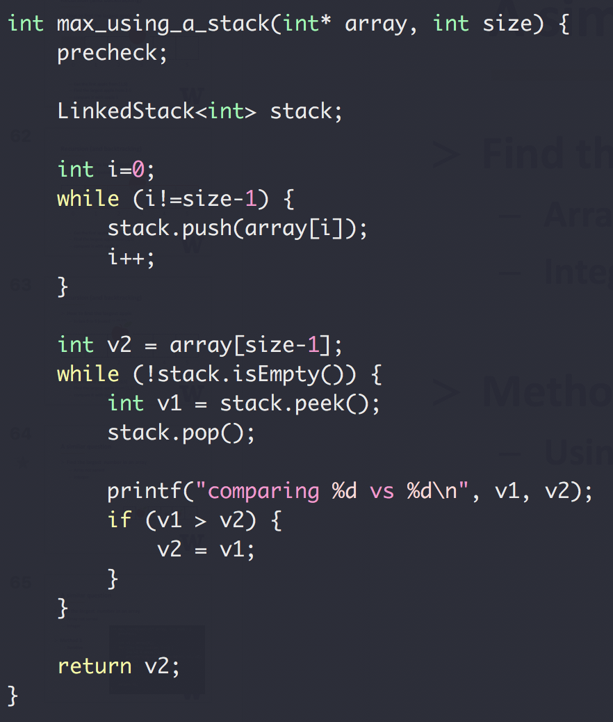
A similar question
Find the largest number in
an array
Array not sorted
Integer
Method 3
Using a stack

Slide 35
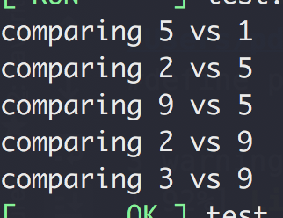
A similar question
Find the largest number in
an array
Array not sorted
Integer
Method 3
Using a stack
Input: [3,2,9,2,5,1]

Slide 36
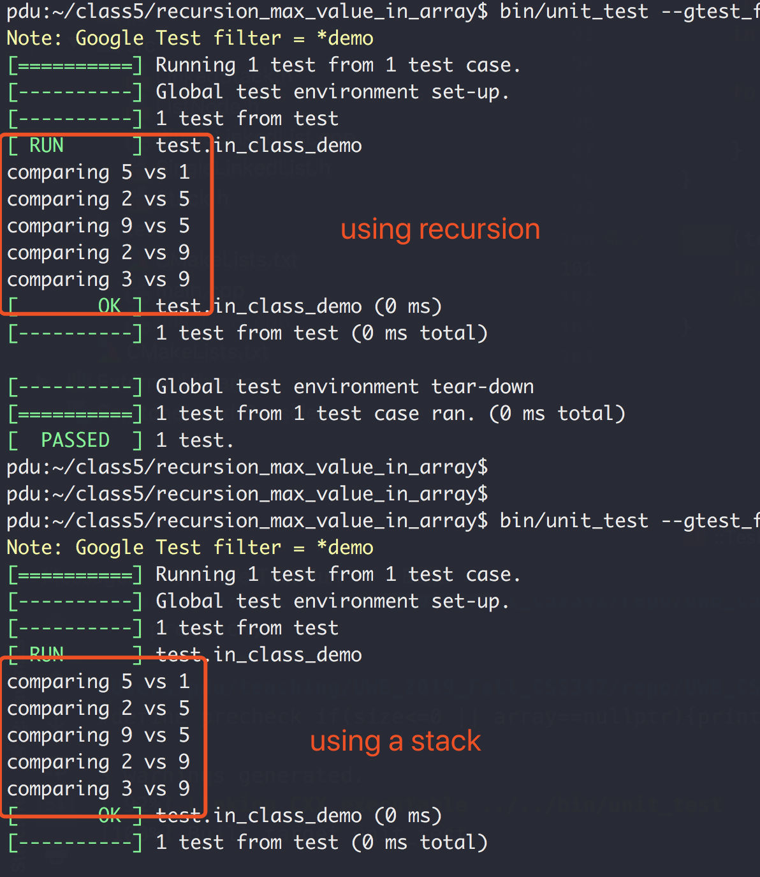
Recursion vs Stack

Slide 37
Recursion
Binary Search
Linear Search (target 12)
5 3 1 9 8 7 12 2 4
5 3 1 8 7 9 2 4 12
O(N) Can we do better?
Worse case we have to iterate N element

Slide 38
Binary Search
“Who checked that bug in?!!”
Source control svn, git, etc
1
2
3
4
5
6
7
8
9
10
Mike
Peng
Ethan

Slide 39

Binary Search
“Who checked that bug in?!!”
Source control svn, git, etc
Found a bug in version 10
No bug in version 1
?
?
?
?
?
?
?
?
1
2
3
4
5
6
7
8
9
10

Slide 40
Binary Search
Source control svn, git, etc
“Who checked that bug in?!!”
Found a bug in version 10
No bug in version 1
?
?
?
?
?
?
?
?
1
2
3
4
5
6
7
8
9
10

Slide 41
Binary Search
Source control svn, git, etc
“Who checked that bug in?!!”
Found a bug in version 10
No bug in version 1
?
?
?
?
?
?
?
?
1
2
3
4
5
6
7
8
9
10

Slide 42
Binary Search
Source control svn, git, etc
“Who checked that bug in?!!”
Found a bug in version 10
No bug in version 1
?
?
?
?
?
1
2
3
4
5
6
7
8
9
10
Bug introduced, found with 3 checks

Slide 43
Binary Search
Binary Search (target 12)
1 2 3 4 5 7 8 9 12
1 2 3 4 5 7 8 9 12
1 2 3 4 5 7 8 9 12
1 2 3 4 5 7 8 9 12
1 2 3 4 5 7 8 9 12
O(logN) both average and worst case

Slide 44
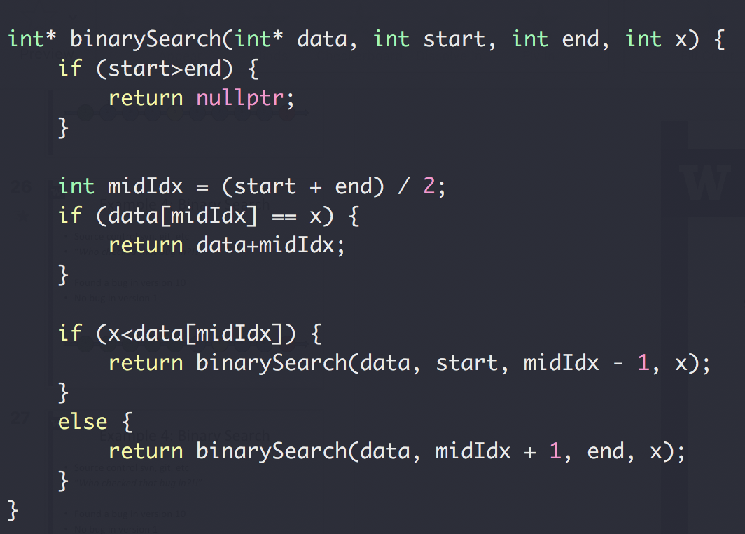
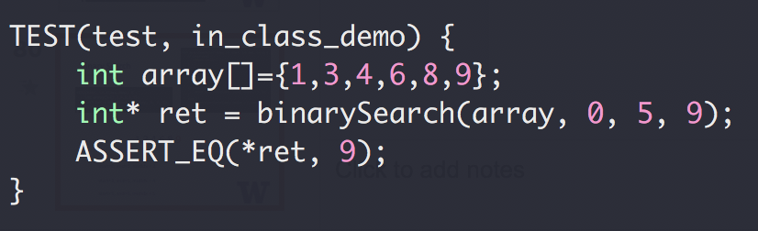
Binary Search

Slide 45
Binary Search
1,3,4,6,8,9
start=0, end=5, midIdx = 2
start=3, end=5, midIdx = 4
start=5, end=5, midIdx = 5

Slide 46
Binary Search
Up to 2³¹-1 for 32-bit signed int
What could go wrong?
The Java programming language library had this bug for 20+ years

Slide 47
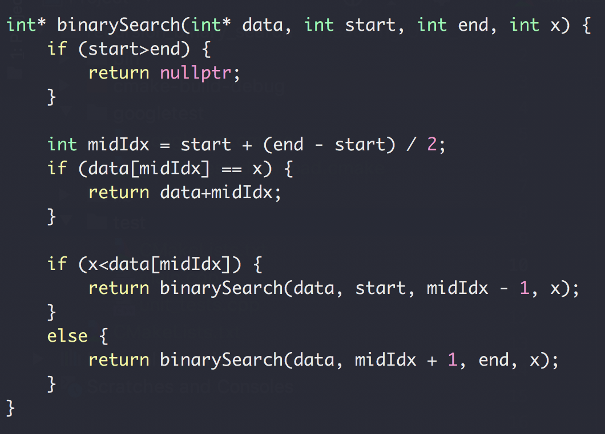

Binary Search

Slide 48
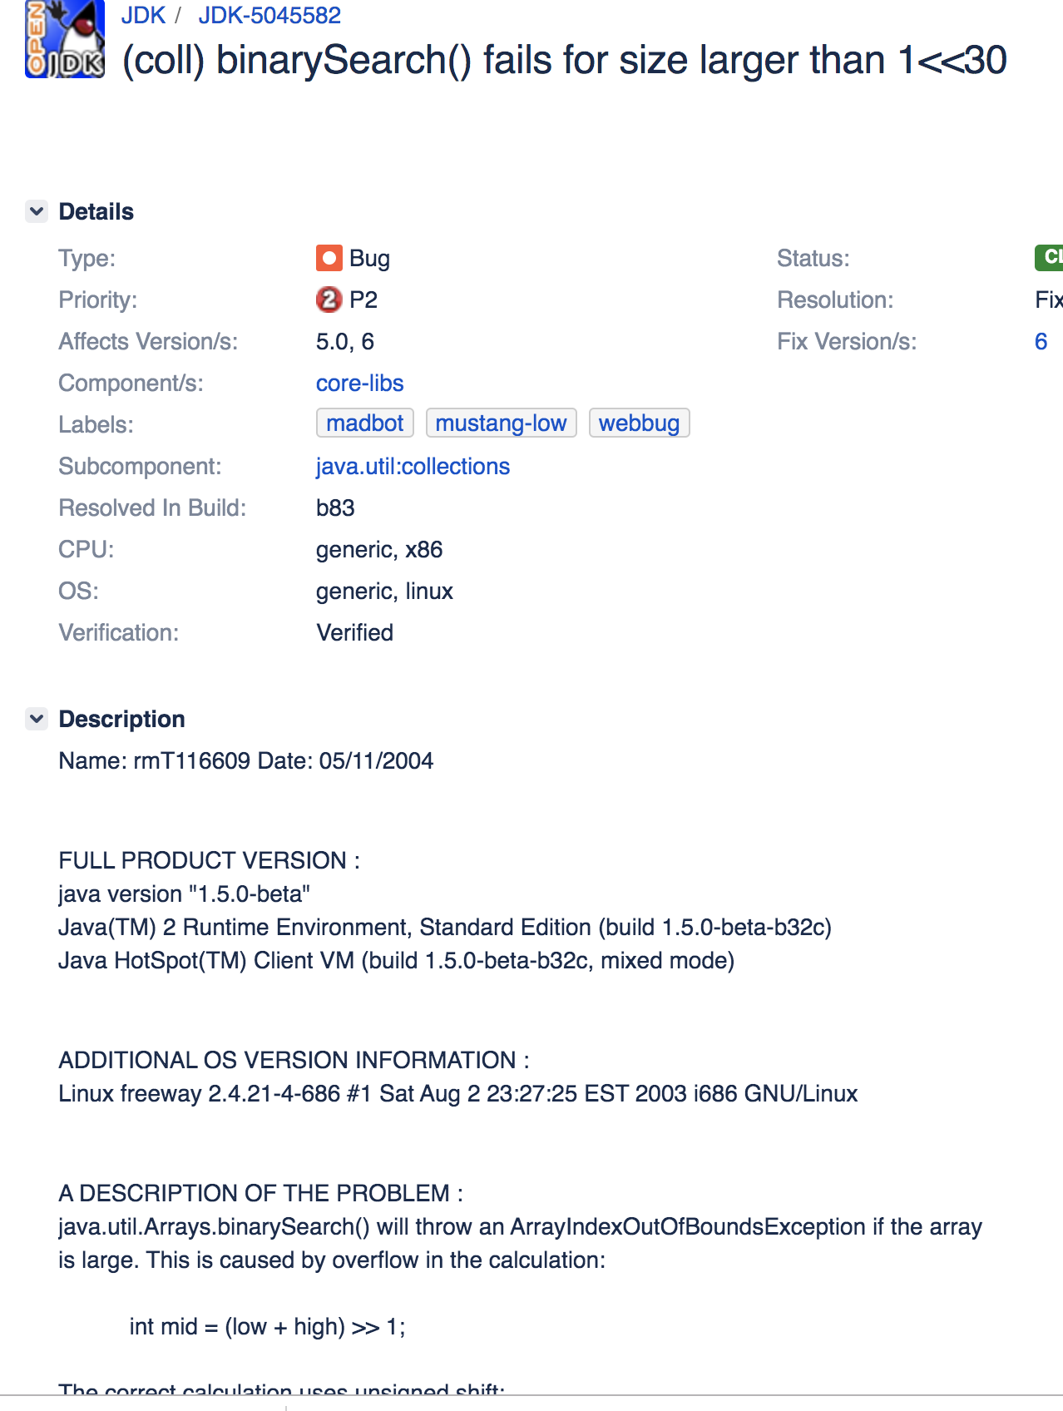
Binary Search
https://bugs.openjdk.java.net/browse/JDK-5045582

Slide 49

Recursion:
You are climbing a stair case. It takes n steps to reach to the top.
Each time you can either climb 1 or 2 steps.
In how many distinct ways can you climb to the top?

Slide 50
Recursion:
You are climbing a stair case. It takes n steps to reach to the top.
Each time you can either climb 1 or 2 steps.
In how many distinct ways can you climb to the top?

Slide 51
Example 4: Climbing Stairs
You are climbing a stair case. It takes n steps to reach to the top. Each time you can either climb 1 or 2 steps.
In how many distinct ways can you climb to the top?
1
n=1
0→1
F(1) = 1
0
0→1→2
N=2
F(2) = 2
0→2

Slide 52
Example 4: Climbing Stairs
You are climbing a stair case. It takes n steps to reach to the top. Each time you can either climb 1 or 2 steps.
In how many distinct ways can you climb to the top?
0→1→3
3
2
N=3
0→1→2→3
1
0
0→2→3

Slide 53
Example 4: Climbing Stairs
You are climbing a stair case. It takes n steps to reach to the top. Each time you can either climb 1 or 2 steps.
In how many distinct ways can you climb to the top?
0→1→3
F(1)
3
2
N=3
0→1→2→3
1
F(2)
0
0→2→3
F(3) = F(2)+F(1)
F(n) = F(n-1)+F(n-2)

Slide 54
Example 4: Code
You are climbing a stair case. It takes n steps to reach to the top. Each time you can either climb 1 or 2 steps.
In how many distinct ways can you climb to the top?

Slide 55
Example 4: Code
You are climbing a stair case. It takes n steps to reach to the top. Each time you can either climb 1 or 2 steps.
In how many distinct ways can you climb to the top?
F(5)
F(4)
F(3)
Overlapping sub problem!
F(3)
F(2)
F(2)
F(1)
F(2)
F(1)
F(1) called 317,811 times when N=30

Slide 56
Example 4: Code
You are climbing a stair case. It takes n steps to reach to the top. Each time you can either climb 1 or 2 steps.
In how many distinct ways can you climb to the top?
F(n) = F(n-1)+F(n-2)
n | 1 | 2 | 3 | 4 | … | 20
F(n) | 1 | 2 | 3 | 5 | … | 10946
Dynamic programming!

Slide 57
Backtracking

Slide 58
